Slide 1
Using API requests

Slide 2
Objective
Use API calls to find the total number of
Bars
Parks
Churches
Gyms
Bookstores
Fast food restaurants
Notes:
We wanted to flex our new API call skills to find and store the total number of all these different types of establishments in almost 400 cities.

Slide 3
Method
Yelp API business search
Notes:
I decided to use Google API but found they have a results cap of 20 results per page. Rather than trying to finagle a work around, we decided to switch to Yelp API since the total number of results is included on the results page.

Slide 4
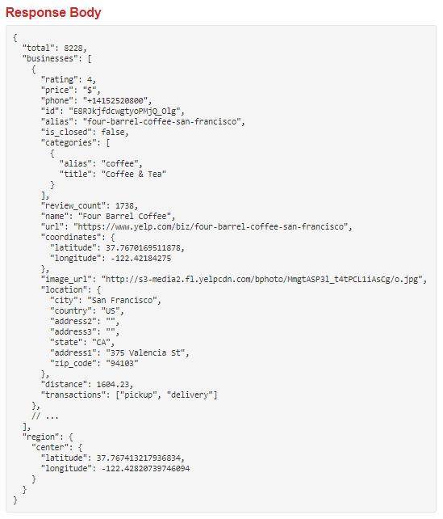
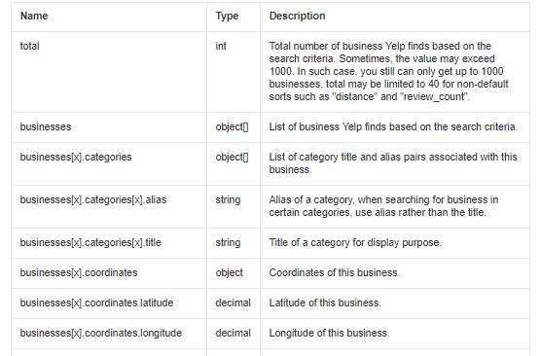
Notes:
We found this after doing a simple google search for “yelp api total number of bars”

Slide 5
Method
Yelp API business search
Imported a Yelp API wrapper
Notes:
It was infuriating trying to get the Yelp API to work, until I remembered such things as API wrappers exist!

Slide 6
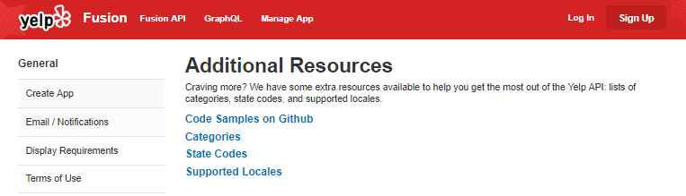
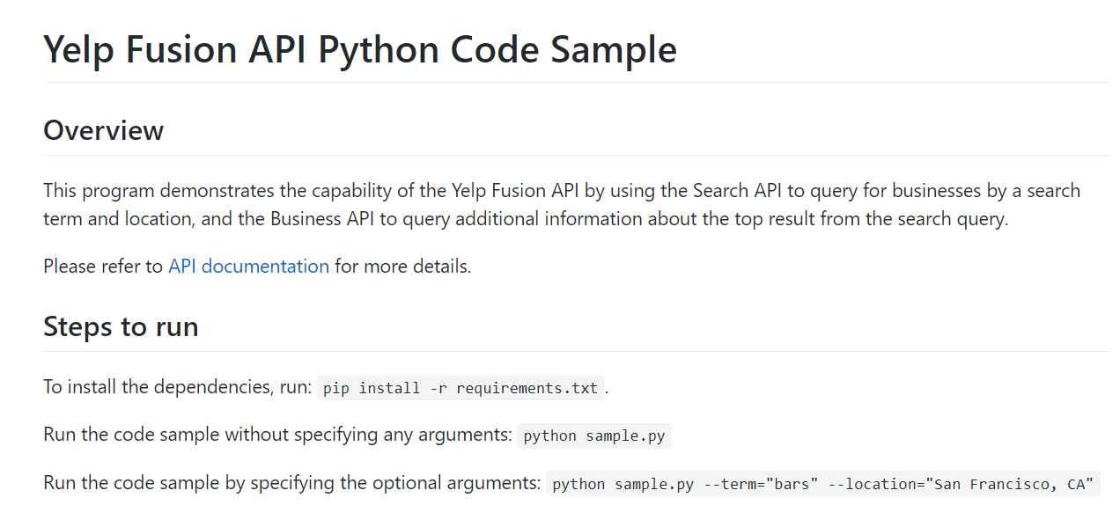
Notes:
Where did I find this magical wrapper you ask??? I basically scoured the Yelp Fusion site out of desparation and Ta-daa I found a solution that worked.

Slide 7
Method
Yelp API business search
Imported a Yelp API wrapper
Read in a CSV containing cities and populations
Notes:
Austin found the data set that we pulled our list of Cities from. Bonus for Yelp API - you don’t have to have latitudes and longitudes!

Slide 8
Method
Yelp API business search
Imported a Yelp API wrapper
Read in a CSV containing cities and populations
Multiple for loops – 1 for each type of establishment
Notes:
I used the Nearest Restaurant example from class to write multiple for loops. Thank you ERIC!

Slide 9
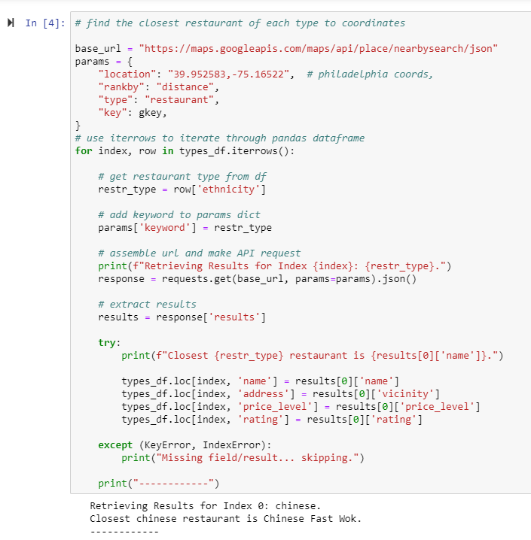
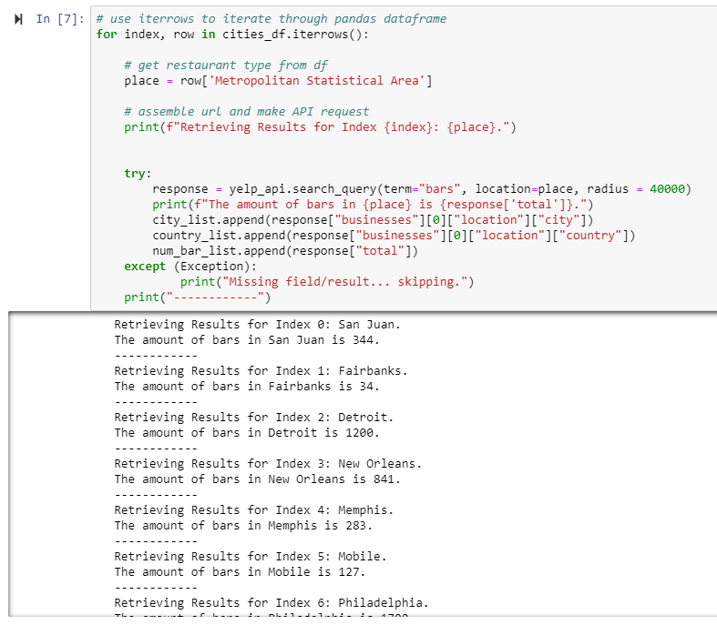
Eric’s code
My code

Slide 10
Method
Yelp API business search
Imported a Yelp API wrapper
Read in a CSV containing cities and populations
Multiple for loops – 1 for each type of establishment
Zipped results into a data frame
Pushed to a new CSV.
Notes:
I decided to use Google API but found they have a results cap of 20 results per page. Rather than trying to finagle a work around, we decided to switch to Yelp API since the total number of results is included on the results page.
It was infuriating trying to get the Yelp API to work, until I remembered such things as API wrappers exist.
I used the Nearest Restaurant example from class to write multiple for loops. Thank you ERIC!
The loops stored their results into lists and from there I used Pandas to convert the lists to 1 data frame.
Finally, I pushed the data frame to a CSV for my team to clean and analyze.

Slide 11
Method
Yelp API business search
Imported a Yelp API wrapper
Read in a CSV containing cities and populations
Multiple for loops – 1 for each type of establishment
Zipped results into a data frame
Notes:
The loops stored their results into lists and from there I used Pandas to convert the lists to 1 data frame.
Finally, I pushed the data frame to a CSV for my team to clean and analyze.

Slide 12
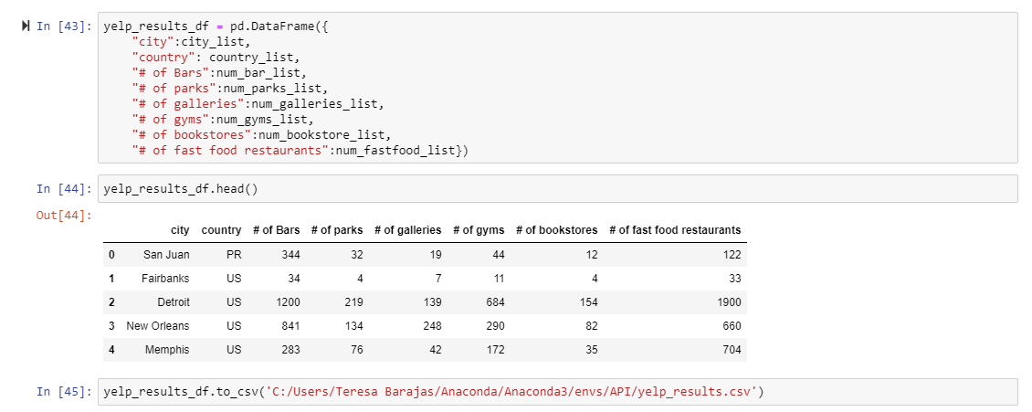

Slide 13
Headwinds
API key cap
Some cities were not found
The API syntax was tricky: “fastfood” vs “fast food”
Notes:
The biggest challenge for this project was maxing out my API keys. The Yelp API has a limit of 5,000 calls per day. Since I was doing 6 loops, 400 calls each, I quickly maxed out my own key. I found that creating check points throughout the code saved time and valuable API calls.
There were several cities that couldn’t be found but thanks to the Nearest Restaurant source code, a simple Try and Except statement allowed us to keep moving.
I can’t stress enough how important it is to look at the results as they’re coming in! The API call for “fast food” was delivering results but stated there was only 3 fast food restaurants in New Orleans (and none of them were Popeyes!) After simply taking out the space between “fast” and “food” the results were looking way more realistic.
Also, since API calls are just a shortcut of running a simple Yelp search, we validated a sample of the results just using the Yelp.com website.

